Slide 1
Introduction to Arduino Programming
Course Instructor: Tejas S Shah

Slide 2

Contents
Introduction to Communication Protocols
Exploring Libraries in Arduino
Shields for Arduino
Understanding and Interfacing OLED Display
Sneak-Peek into Embedded world

Slide 3
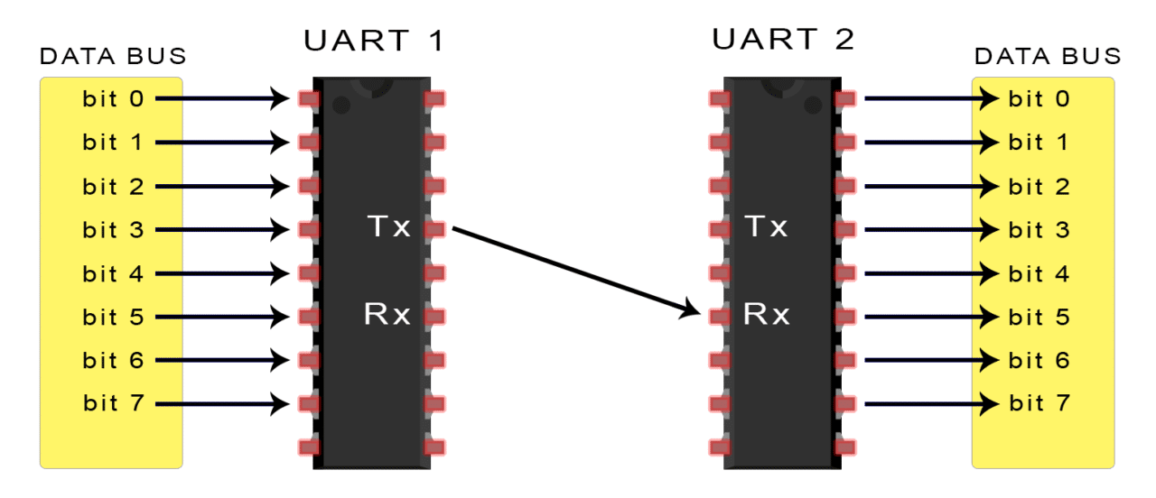
UART
It’s not a communication protocol like SPI and I2C, but a physical circuit in a microcontroller, or a stand-alone IC. A UART’s main purpose is to transmit and receive serial data.
This transmission method is perfect for minimizing the required wires and I/O pins, but it does mean we need to put some extra effort into reliably transferring and receiving data.

Slide 4
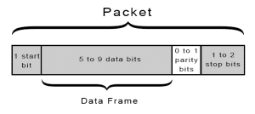
UART transmitted data is organized into packets. Each packet contains 1 start bit, 5 to 9 data bits (depending on the UART), an optional parity bit, and 1 or 2 stop bits:
Parity Bit: Parity describes the evenness or oddness of a number. The parity bit is a way for the receiving UART to tell if any data has changed during transmission.

Slide 5
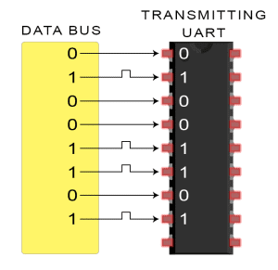
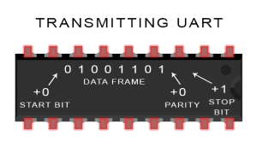
Working
Step 1
Step 2
The transmitting UART receives data in parallel from the data bus:
The transmitting UART adds the start bit, parity bit, and the stop bit(s) to the data frame:

Slide 6
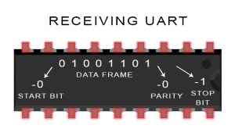
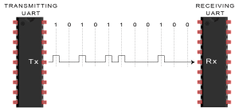
Step 3
Step 4
The entire packet is sent serially from the transmitting UART to the receiving UART. The receiving UART samples the data line at the pre-configured baud rate:
The receiving UART discards the start bit, parity bit, and stop bit from the data frame:
Step 5
The receiving UART converts the serial data back into parallel and transfers it to the data bus on the receiving end:

Slide 7
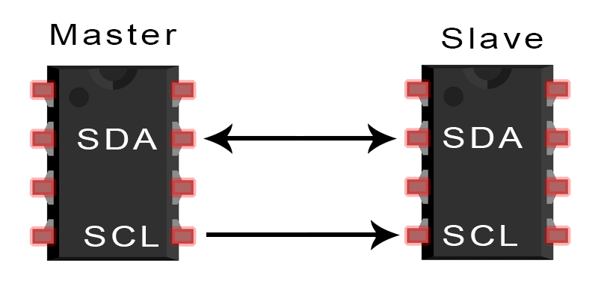
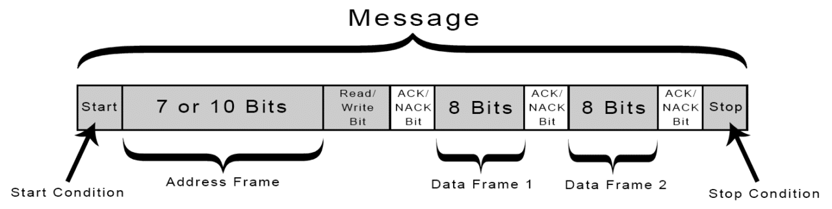
I2C
I2C combines the best features of SPI and UARTs. With I2C, you can connect multiple slaves to a single master (like SPI) and you can have multiple masters controlling single, or multiple slaves.
I2C is a serial communication protocol, so data is transferred bit by bit along a single wire (the SDA line).
SDA (Serial Data) – The line for the master and slave to send and receive data.
SCL (Serial Clock) – The line that carries the clock signal.

Slide 8
Exploring Libraries
EEPROM: Used to store and read information in memory that is preserved when power is removed.
Ethernet: Used to communicate with the Arduino Ethernet shield.
LiquidCrystal: For controlling compatible LCD displays
Servo: Used to control servo motors
SoftwareSerial: Enables additional serial ports
SPI: Used for SPI hardware
Stepper: For working with stepper motors
Wire: Works with I2C devices attached to the Arduino

Slide 9
How to use Libraries
Libraries are often written to simplify the use of a piece of hardware.
To see the list of available libraries from the IDE menu, click Sketch→Import Library.
A list will drop down showing all the available libraries. The first dozen or so are the libraries distributed with Arduino. A horizontal line separates that list from the libraries that you download and install yourself.
Clicking on a library will add that library to the current sketch, by adding the following line to the top of the sketch: #include <nameOfTheLibrarySelected.h>.

Slide 10
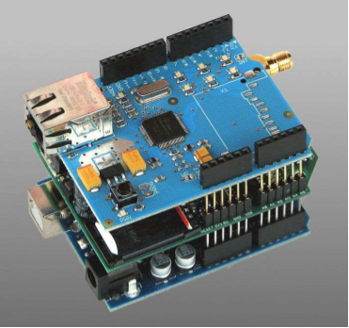
Arduino Shields
Shields are modular circuit boards that piggyback onto your Arduino to instill it with extra functionality.
Many Arduino shields are stackable. You can connect many shields together to create a "Big Mac" of Arduino modules. You could, for example, combine an Arduino Uno with a Voice Box Shield, and a WiFly Shield to create a WiFi Talking Stephen Hawking(TM).

Slide 11
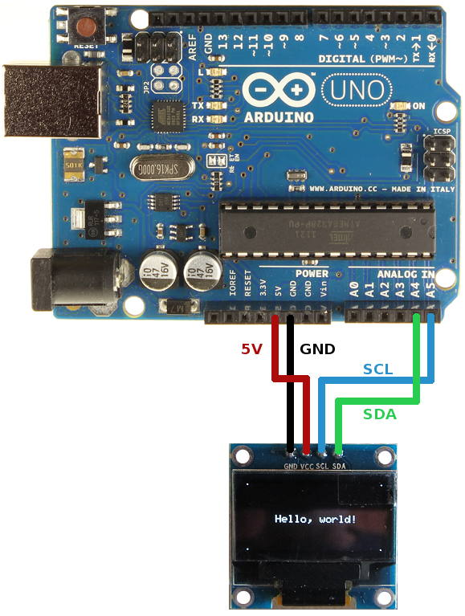
Understanding and Interfacing OLED Display
OLEDs work in a similar way to conventional diodes and LEDs.
We can make an OLED produce colored light by adding a colored filter into our plastic sandwich just beneath the glass or plastic top or bottom layer.
The organic light-emitting diode (OLED) display used here is the SSD1306 model: a monocolor, 0.96-inch display with 128×64 pixels.

Slide 12
Library and Methods
How to Install?
Sketch > Include Library > Manage Libraries
Type “SSD1306” in the search box and install the SSD1306 library from Adafruit.
After installing the SSD1306 library from Adafruit, type “GFX” in the search box and install the library.
After installing the libraries, restart your Arduino IDE.
Methods Available?
display.clearDisplay() – all pixels are off
display.drawPixel(x,y, color) – plot a pixel in the x,y coordinates
display.setTextSize(n) – set the font size, supports sizes from 1 to 8
display.setCursor(x,y) – set the coordinates to start writing text
display.print(“message”) – print the characters at location x,y
display.display() – call this method for the changes to make effect

Slide 13
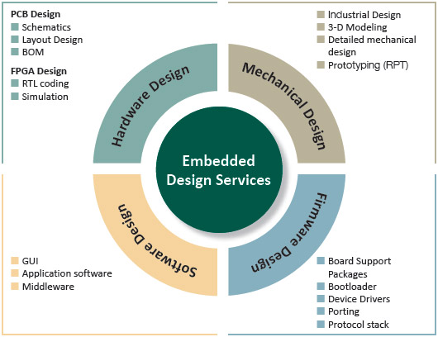
Sneak-Peek into Embedded world
An embedded system is a combination of computer hardware and software designed for a specific function or functions within a larger system.
A mobile phone is not an embedded system, it is a combination of embedded systems that together allow it to perform a variety of general-purpose tasks.

Slide 14
Embedded systems vary in complexity, but generally consist of three main elements:
Hardware. The hardware of embedded systems is based around microprocessors and microcontrollers.
Software. Software for embedded systems can vary in complexity. However, embedded systems generally run very simple software that requires little memory.
Firmware. Embedded firmware is usually used in more complex embedded systems to connect the software to the hardware. Firmware is the software that interfaces directly with the hardware.

Slide 15
Project Proposal Submission
Task
Write a simple 2-3 page Project Proposal document for an Arduino-based project.
Contents
Abstract (4-5 lines)
Bill-of-Materials (List of components used)
Circuit Diagram (Hand Drawn/Fritzing/TinkerCAD/others)
Flowchart/Algorithm/Code
Conclusion & Future Scope
Note: This is a compulsory graded (Pass/Fail) assignment.
Deadline: 15th July 2020

Slide 16
Thank You
End of Workshop. Questions?

